Slide 1
21/02/2022
Title: Operations with integers
Aim:
Be able to apply the 4 operations to rational numbers, both positive and negative.
Know what is meant by an irrational number.
Plan:
Daily review:
Decimal addition / subtraction
4 operations independent practice.
Irrational numbers

Slide 2
Double signs:
Adding a negative number is the same as
Subtracting a negative number is the same as
subtracting.
adding.
– 6
5 + (-6) can be written as 5
+ 3
-7– (-3) can be written as 7
Multiplication and division:
Multiplying a positive number by a negative number will always give a ____________ result.
negative
Multiplying a negative number by a positive number will always give a ______________ result.
negative
Multiplying a negative number by a negative number will always give a ___________ result.
positive

Slide 3
Multiplication and division:
Dividing a positive number by a negative number will always give a ____________ result.
negative
Multiplying a negative number by a positive number will always give a ______________ result.
negative
Multiplying a negative number by a negative number will always give a ___________ result.
positive

Slide 4
Daily review:
Decimal addition / subtraction
Addition and subtraction of rational numbers.
Line up decimal points.
Start working from right hand side.
234.75 + 23.1
234.75
+ 23.1
231.54 – 42.8
231.54
- 42.8

Slide 5
-32.76 + (-56.89)
= -32.76 – 56.89
= - (32.76 + 56.89)
=
Double sign
Number line

Slide 6
45.56 – 67.345
= -(67.345 – 45.56)
=
-32.64 + 65.8
= 65.8 – 32.64

Slide 7
Independent practice
128.2 – (-41.76)
-35.6 – (-45.1)
56.267 – 65.98
112 – 34.654
-203.98 + 47.93

Slide 8
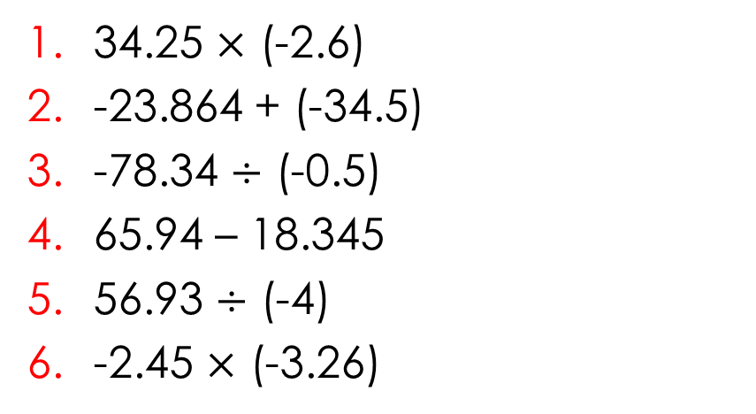
4 Operations rational numbers
34.25 $×$ (-2.6)
-23.864 + (-34.5)
-78.34 $÷$ (-0.5)
65.94 – 18.345
56.93 $÷$ (-4)
-2.45 $×$ (-3.26)

Slide 9
Irrational numbers
To understand the concept of an irrational number, we must first understand what is meant by a rational number.
Rational – ratio nal
Ratio is a noun.
Rational is an adjective.
A number is considered a rational number if it can be written as one integer divided by another integer. ... Rational numbers can be positive, negative or zero. When we write a negative rational number, we put the negative sign either out in front of the fraction or with the numerator.

Slide 10
All terminating decimals are rational.
All non terminating decimals that recur are rational.
All non terminating decimals that do not recur are irrational.
$π$ is the most well known irrational number.

Slide 11
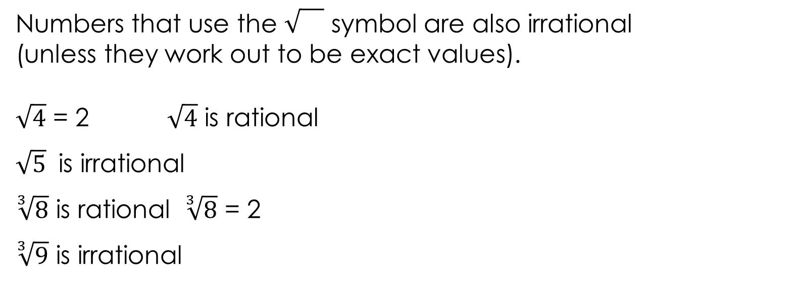
Numbers that use the symbol are also irrational
(unless they work out to be exact values).
$\sqrt{4}$ = 2 $\sqrt{4}$ is rational
$\sqrt{5}$ is irrational
$\sqrt[3]{8}$ is rational $\sqrt[3]{8}$ = 2
$\sqrt[3]{9}$ is irrational

Slide 12
Rational numbers 4 operations practice sheet.
Write answers on the sheet.

